Slide 1
Riunione Comitato Italiano – Palau 4-7 Maggio 2022
u
Massimo Pompili, University of Roma La Sapienza

Slide 2
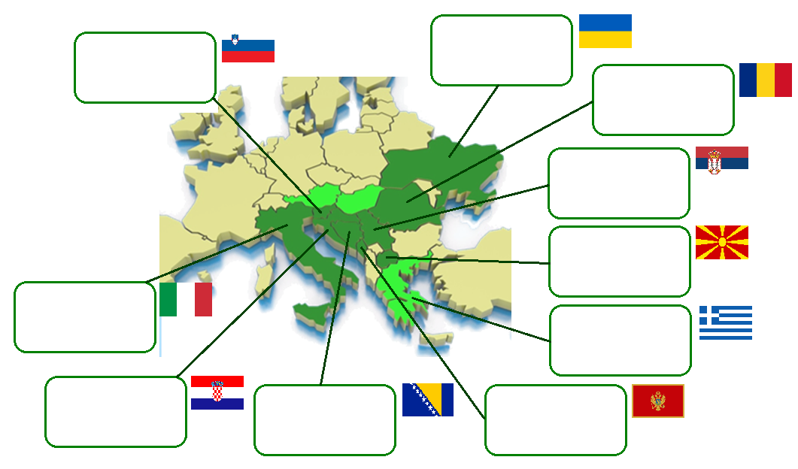
Consumption 150721 GWh
Production 198120 GWh
Installed Capacity 53780 MW
kWh/capita 3316 kWh
Consumption 12631 GWh
Production 14544 GWh
Installed Capacity 3873 MW
kWh/capita 6145 kWh
Consumption 53930 GWh
Production 59042 GWh
Installed Capacity 21900 MW
kWh/capita 2838,4 KWh
Consumption 35000 GWh
Production 34509 GWh
Installed Capacity 7142 MW
kWh/capita 4915 kWh
As in 2012
Consumption 8488 GWh
Production 5925 GWh
Installed Capacity 1940 MW
kWh/capita 4112 kWh
Consumption 307219 GWh
Production 263353 GWh
Installed Capacity 134634 MW
kWh/capita 5168 kWh
Consumption 50588 GWh
Production 50997 GWh
Installed Capacity 17875 MW
kWh/capita 4677,5 kWh
Consumption 16600 GWh
Production 8600 GWh
Installed Capacity 4401 MW
kWh/capita 3875 kWh
Consumption 11853 GWh
Production 12235 GWh
Installed Capacity 3800 MW
kWh/capita 3087 kWh
Consumption 3942 GWh
Production 2713 GWh
Installed Capacity 867 MW
kWh/capita 6358 kWh
2019 Questionnaire Preliminary Results

Slide 3
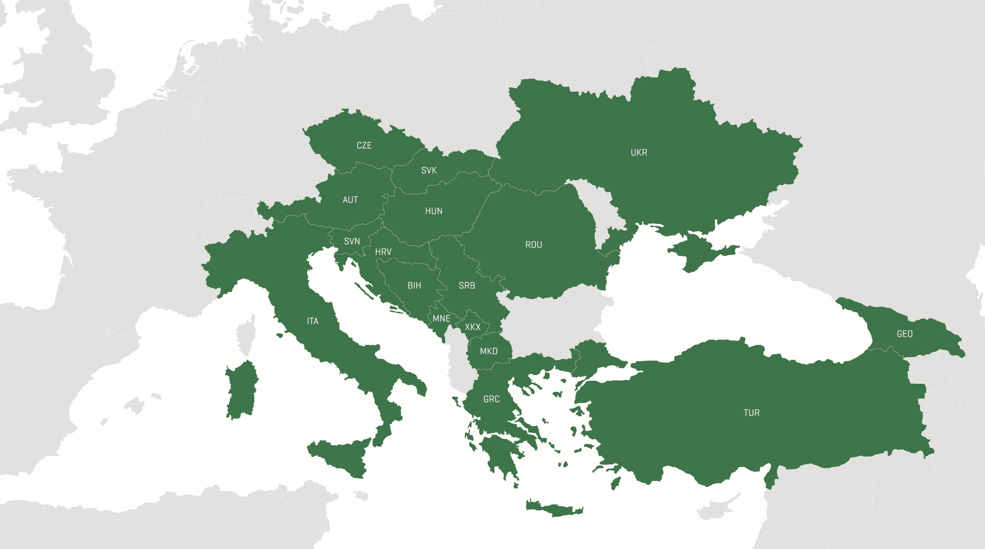
HUNGARY
Consumption 45.460 GWh
Production 32.584 GWh
Installed Capacity 8,6 GW
kWh/capita 4.639 kWh
ROMANIA
Consumption 48.400 GWh
Production 63.784 GWh
Installed Capacity 23,7 GW
kWh/capita 2.464 kWh
SERBIA (2012)
Consumption 35.000 GWh
Production 34.509 GWh
Installed Capacity 7.142 MW
kWh/capita 4.915 kWh
UKRAINE
Consumption 118.000 GWh
Production 155.000 GWh
Installed Capacity 51,8 GW
kWh/capita 2.781 kWh
MONTENEGRO
Consumption 3.114 GWh
Production 2.329 GWh
Installed Capacity 0,97 GW
kWh/capita 5.000 kWh
SLOVAKIA (WB Data)
Consumption 28.000 GWh
Production - GWh
Installed Capacity - GW
kWh/capita 5.137 kWh
KOSOVO
Consumption 5.686 GWh
Production 5.300 GWh
Installed Capacity 1,4 GW
kWh/capita 3.161 kWh
CZECH REPUBLIC (WB Data)
Consumption 65.000 GWh
Production - GWh
Installed Capacity - MW
kWh/capita 6.258 kWh
NORTH MACEDONIA (2012)
Consumption 8.488 GWh
Production 5.925 GWh
Installed Capacity 1.940 MW
kWh/capita 4.112 kWh
AUSTRIA
Consumption 66.274 GWh
Production 70.823 GWh
Installed Capacity 25,4 GW
kWh/capita 7.521 kWh
GEORGIA
Consumption 12.700 GWh
Production 11.056 GWh
Installed Capacity 4,1 GW
kWh/capita 3.416 kWh
SLOVENIA
Consumption 15.810 GWh
Production 15.400 GWh
Installed Capacity 3,6 GW
kWh/capita 7.637 kWh
ITALY
Consumption 301.880 GWh
Production 295.800 GWh
Installed Capacity 117,1 GW
kWh/capita 4.991 kWh
CROATIA
Consumption 18.197 GWh
Production 11.056 GWh
Installed Capacity 47,8 GW
kWh/capita 4.246 kWh
BOSNIA AND HERZEGOVINA
Consumption 12.274 GWh
Production 14.627 GWh
Installed Capacity 4,2 GW
kWh/capita 3.495 kWh
GREECE
Consumption 57.500 GWh
Production 45.878 GWh
Installed Capacity 16,5 GW
kWh/capita 5.316 kWh
TURKEY
Consumption 296.702 GWh
Production 297.278 GWh
Installed Capacity 85,2GW
kWh/capita 3.671 kWh
2019 Questionnaire Preliminary Results
As in 2022

Slide 4
HISTORY OF SEERC
The South East European Region of CIGRE (SEERC) is the fourth World Region of Cigre and was established on 13 May 2013 in the small Adriatic town Miločer in Montenegro (Bosnia-Herzegovina, Croatia, Italy, Macedonia, Montenegro, Romania, Serbia, Slovenia and Ukraine).
Start of operation was happened in Rome, Italy, on 27 January 2014, at the University of Rome (La Sapienza). Main actions agreed in Rome were decision for preparation of SEERC Position paper and a Questionnaire on technical data and interests for cooperation and framework of Technical work
Seventh Management Board meeting was on 30 August 2018 in Paris, France. At that time the chair of TAC was Wolfgang Hribernik with Klemens Reich (Austria) who announced that next SEERC conference will be on 16-17 June 2020 in Vienna and then postponed up tO JUNE 2022

Slide 5
SEERC CONFERENCES
FIRST SEERC CONFERENCE was on 7-8 June 2016 in the North Adriatic town Portoroz, Slovenia. Conference dealt with four topics:
1. Energy and Environmental Policy in the Region,
2. Submarine Cables Issues in the Region,
3. Regional Energy Market Aspects, and
4. Innovation in Electric Power Infrastructure of the Region.
SECOND SEERC CONFERENCE was on 12-13 June 2018 in Kyiv, Ukraine. Conference dealt with three topics:
1. Regional Aspects of Electricity Market Development ,
2. Resilience Issues of Electric Power systems in Region, and
3. Innovation in Electric Power Infrastructure of the Region.

Slide 7
3th SEERC CONFERENCE - Vienna (Austria) –

Slide 8
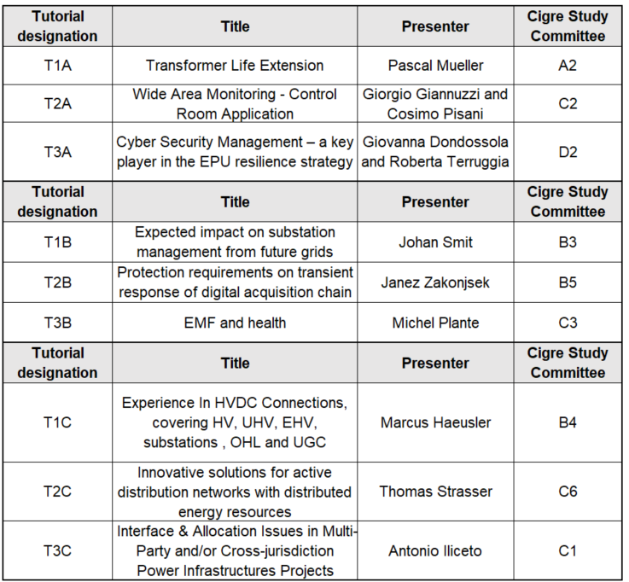
3th SEERC CONFERENCE - Vienna (Austria).

Slide 9
3th SEERC CONFERENCE - Vienna (Austria).
History Panel to take place during the SEERC Conference in Vienna and it will include the following: 1. Prof. Roman Sandgruber's presentation on the introduction of Polyphase Power Systems after the 3rd International Electrical Exposition in Vienna in year 1883.
2. Dott. Goran Slipac (Croatia) Three Phase power plant and overhead line (Tivoli – Roma in Italy, HPP Jaruga and OHL to Šibenik in the year 1895 using Ganz technology) 3. Prof. Massimo Pompili (Italy) presentation of some outstanding Italian cases at the onset of Polyphase Power System Deployment in Italy (Galileo Ferraris studies).

Slide 10
3th SEERC CONFERENCE - Vienna (Austria).
SEERC Regional Groups
RWG01: Regional aspects on creation of NNA for new standard for overhead lines EN 50341 (Kresimir BAKIC)
RWG02: Regional perspective of shunt reactor introduction in the transmission system (Maks BABUDER)
RWG03: Environmental and technical assessment for submarine cables siting issue in Mediterranean area (Massimo POMPILI)
RWG04: Technical and economical features of Hydro Pumped storage power plants (HPSPPs) in power systems (Yuriy BONDARENKO)

Slide 11
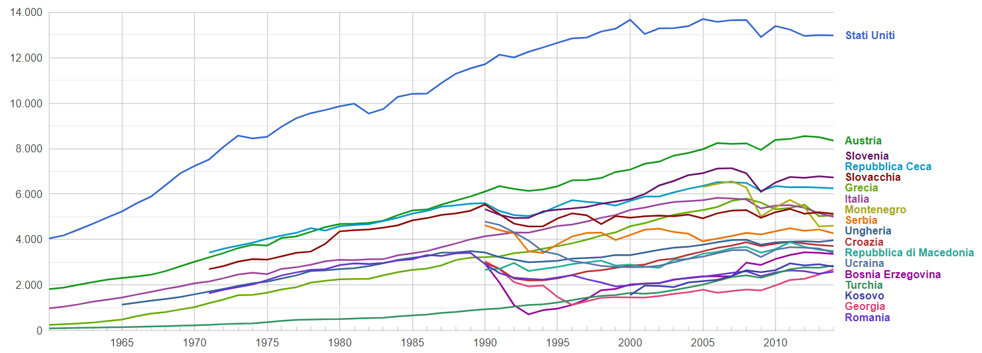
General Outlook – Consumption/capita [kWh/capita]
(WB data)
2019 Questionnaire Preliminary Results

Slide 12
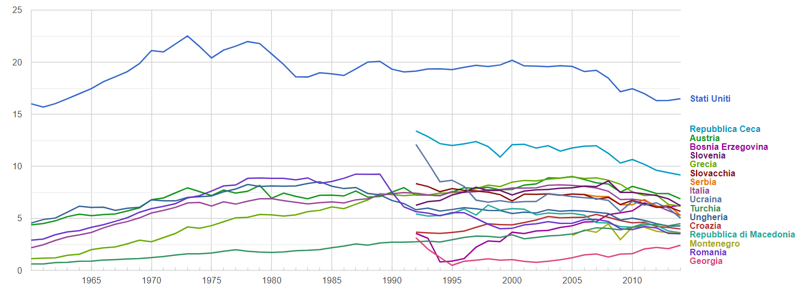
General Outlook – CO2 Emission [ton/capita]
(WB data)
2019 Questionnaire Preliminary Results

Slide 13
Energy Outlook - Seasonal Peak load in 2017 (MW)
Reference year 2017
Data for Serbia, North Macedonia, Czech Rep. And Slovakia are in preparation
2019 Questionnaire Preliminary Results

Slide 14
Energy Outlook - Consume and Production in 2017 (GWh)
Reference year 2017 – Consume SEERC: 1.002.000 GWh; Production SEERC: 1.021.000 GWh
Data for Serbia, North Macedonia, Czech Rep. And Slovakia are in preparation
2019 Questionnaire Preliminary Results

Slide 15
3.2 | Generation
3.2.1 | General
 | Installed Capacity | 113,0 |  | MW
 | Annual Production | 273,1 |  | GWh
 | Annual Electricity Export | 7,6 |  | GWh
 | Annual Electricity Import | 39,8 |  | GWh
3.2.2 | Thermal Generation
 | Nuclear | 0 | MW | 0 | GWh
 | (Gas & oil) + biomass | 46,2 + 3,5 | MW |  | GWh
 | Coal | 7,1 | MW |  | GWh
 | Sub-total | 56,8 | MW | 175.376 | GWh
3.2.3 | Hydro Generation
 | Sub-total | 23,0 | MW | 47.999 | GWh
3.2.4 | Renewables
 | Wind | 10,8 | MW | 18.547 | GWh
 | Solar (PV) | 21,5 | MW | 25.549 | GWh
 | Geothermal | 0,9 | MW | 5.646 | GWh
 | Sub-total | 33,2 | MW | 49.742 | GWh
2019 Questionnaire Preliminary Results

Slide 17
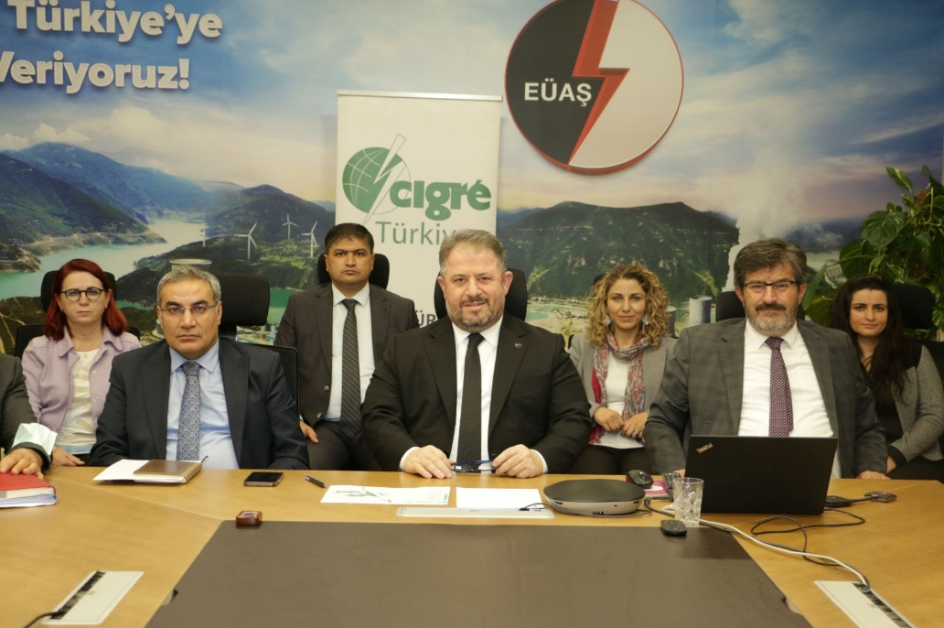
CIGRE National Committee of Türkiye has taken over the SEERC chairmanship from Austria NC on 30 November 2021.
CIGRE NC of Türkiye will hold the 4th SEERC Conference in October 2023 which is the 100° Anniversary of Türkiye’s establishment.
The conference will bring the officials, academics, experts and SEERC family, the bridge between Europe and Asia.
Dr. İzzet ALAGÖZ Chairman for CIGRE Türkiye National Committee
Dr. Ahmet Merev
University of Instambul

Slide 18
Riunione Comitato Italiano – Palau 4-7 Maggio 2022
GRAZIE PER L’ATTENZIONE
u
Massimo Pompili, University of Roma La Sapienza

