Slide 1



TraNSIZIONE ENERGETICA E RUOLO DEL TSO
Med-TSO ed il Mediterraneo
Angelo Ferrante, Segretario Generale Med-TSO
Workshop Cigre Italia «Impatto della transizione energetica sul sistema elettrico»
Palau (OT), 4 maggio 2022
Co-funded by
the European Union

Slide 2
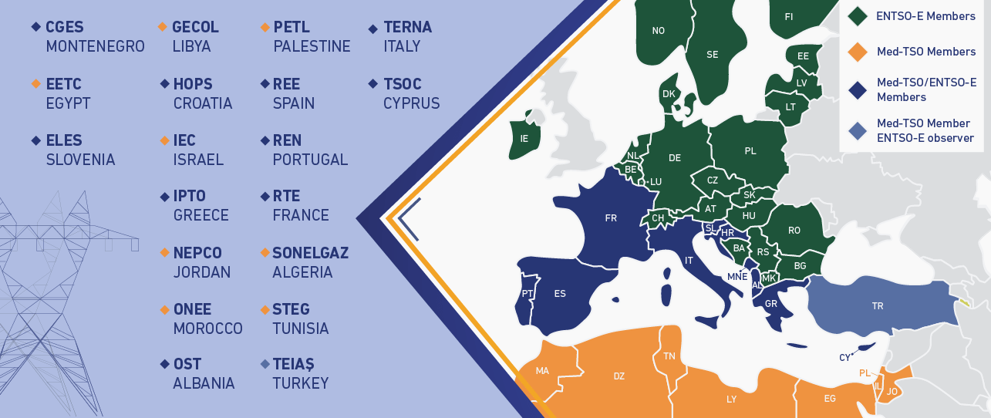
Med-TSO: multilateral cooperation in the Mediterranean
22 members from 20 Med countries
> 500 million people served
~ 544.000 MW installed capacity
~ 400.000 km transmission lines
> 1.600 TWh electricity consumption
A bridge between Europe and the MENA Region, acting as THE reference regional stakeholder for electricity
Playing a regional reference role for creating a favorable climate for the development of North-South and South-South interconnections
Launching pilot projects to strengthen the integration of the MENA Power Systems
Support the EC in its Euro-Mediterranean initiatives
Bottom-up approach

Slide 3
The role of electricity in decarbonisation
Optimal cost coupling between supply and demand minimising decarbonisation costs
Energy efficiency is the primary instrument for reaching carbon neutrality
Electricity as dominant energy carrier
Grid as the backbone of the decarbonisation of the other energy sectors
Direct use of electricity is the most efficient solution
Electrification of end uses must be favored wherever it is technically and economically sustainable
Indirect electrification is necessary for “hard to abate” sectors through Power-to-X (P2X)
  heavy industry
  heavy duty transport
  maritime transport
  aviation

Slide 4





Enabling factors to energy transition
INFRASTRUCTURE DEVELOPMENT
    Reinforcement of national grid and interconnections with foreign countries
Increase installation rates and planning on a long-term basis
leveraging on technological differentiation in energy sources portfolio
Prioritize at the administrative level and carry out awareness campaigns
RENEWABLES DEVELOPMENT
capacity remuneration mechanisms
    Complement spot markets with medium/long term markets based also on capacity remuneration/availability
STORAGE
New storage systems to provide active and reactive power control, ensure adequacy, manage overgeneration and residual load ramps
    Evolution and integration of markets to have new flexibility resources in the grid ancillary services markets (DSR and storage systems, electrical vehicles, etc )
FLEXIBILITY RESOURCES

Slide 5
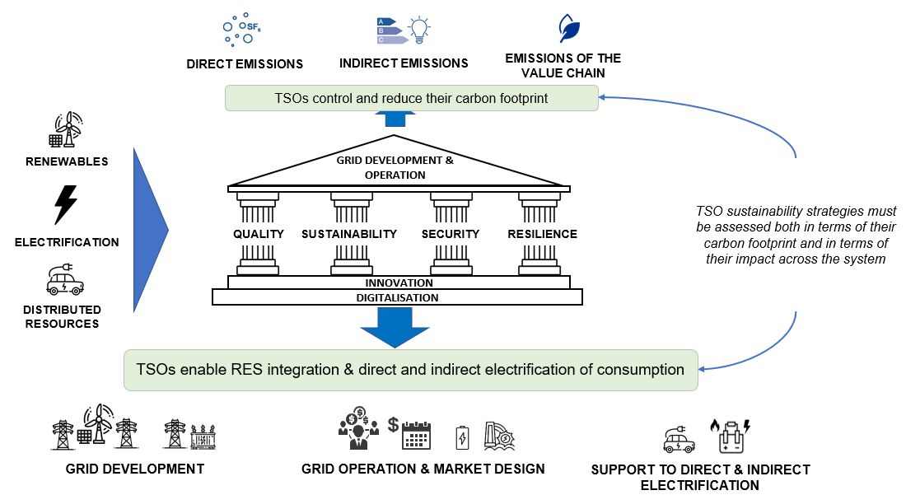
The role of TSOs in the decarbonisation of the energy system

Slide 6
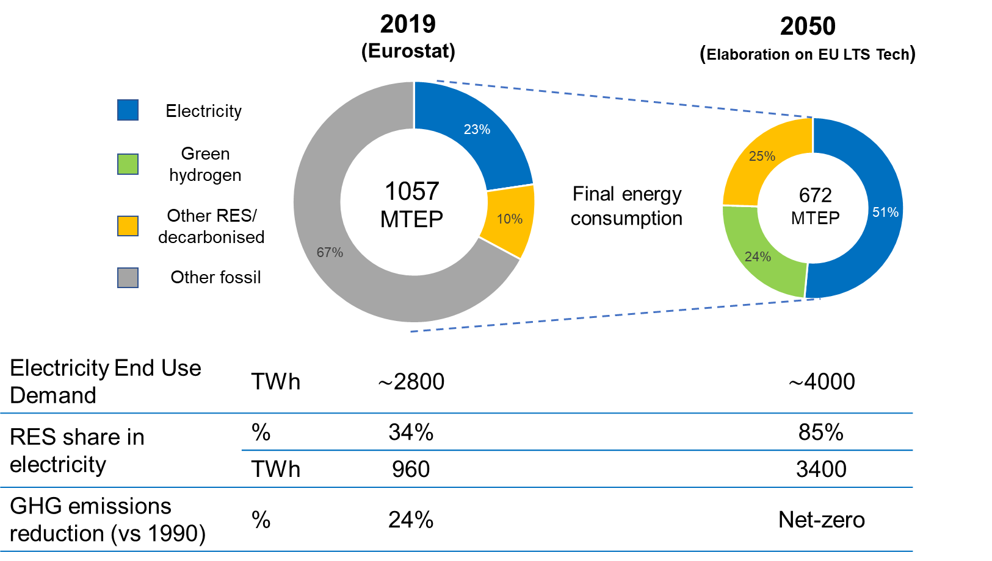
The role of electricity in decarbonisation – focus on EU
CO₂ emission reduction target
2019
2030
2050
- 40%
European Green Deal
- 55%
NET ZERO EMISSION
-24%
Clean Energy Package
(Source: Eurostat and EU Long-Term Strategy)

Slide 7
Energy transition in the Mediterranean context
1
2
All countries involved in the energy transition
TSOs called to adapt to this new context
Integration is no
longer an option
  Need of investments in gas (medium term) & RES
  System operation more complex due to fast and massive growth of RES
  Needs for more system flexibility
Inadequate interconnection level is a barrier
3
4
Challenges
Integration is a key driver
  Limited or non efficient use of grids & interconnections
  Unstable environment for investors: market fragmentation, lack of long-term price signals
Reduced mkt fragmentation
Share balancing resources
Complementarities:
seasonal
hourly
generation mix
Reinforced cooperation
is essential

Slide 8
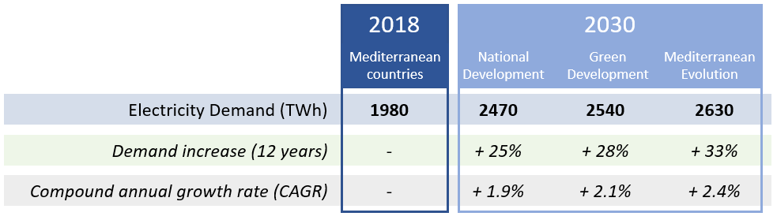
Three possible scenarios: demand increase at 2030
Electricity consumption expected to increase from 25 to 33% by 2030 in different scenarios
Contrasting dynamics between the Mediterranean countries:
stability in the demand for the North-West countries
strong increase (between 40 and 80% in 12 years) in the other groups
HERE PICTURE

Slide 9
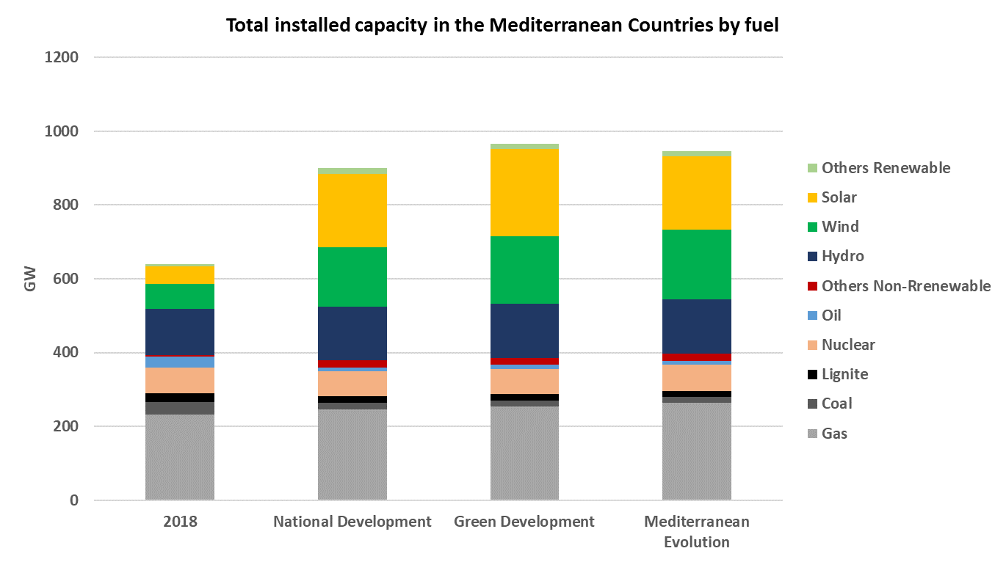
Three possible scenarios: generation pattern at 2030
Increased generation capacity (SoS and decarbonization)
Reduction in coal
Stability in gas (reduction in Europe, increase in the other countries)
Slight decrease of nuclear
Increase of hydro generation in some countries, but also of hydro pumped storage plants where possible
Huge development of solar and wind in all the countries (including offshore), driven by price reduction and natural resources

Slide 10
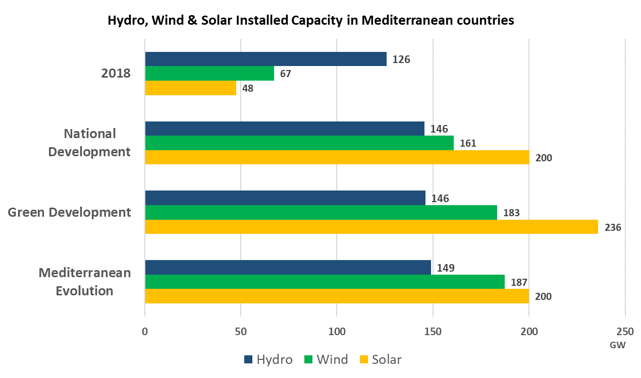
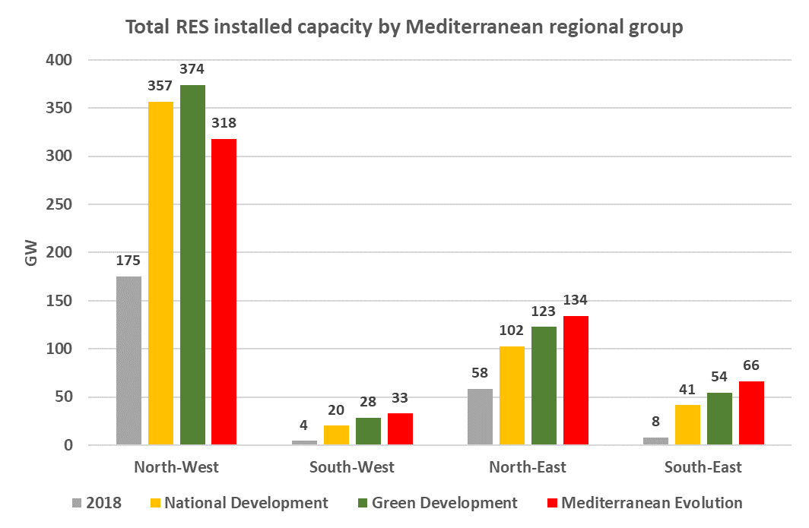
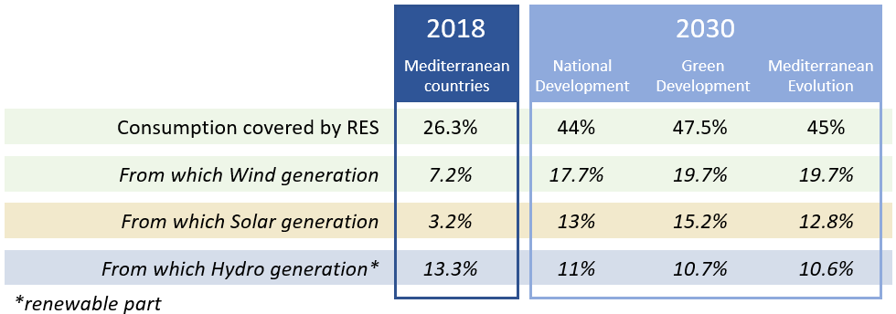
RES increase to cover new electricity demand
Wind: x 3 in 12 years
Solar: x 4-5 in 12 years

Slide 11
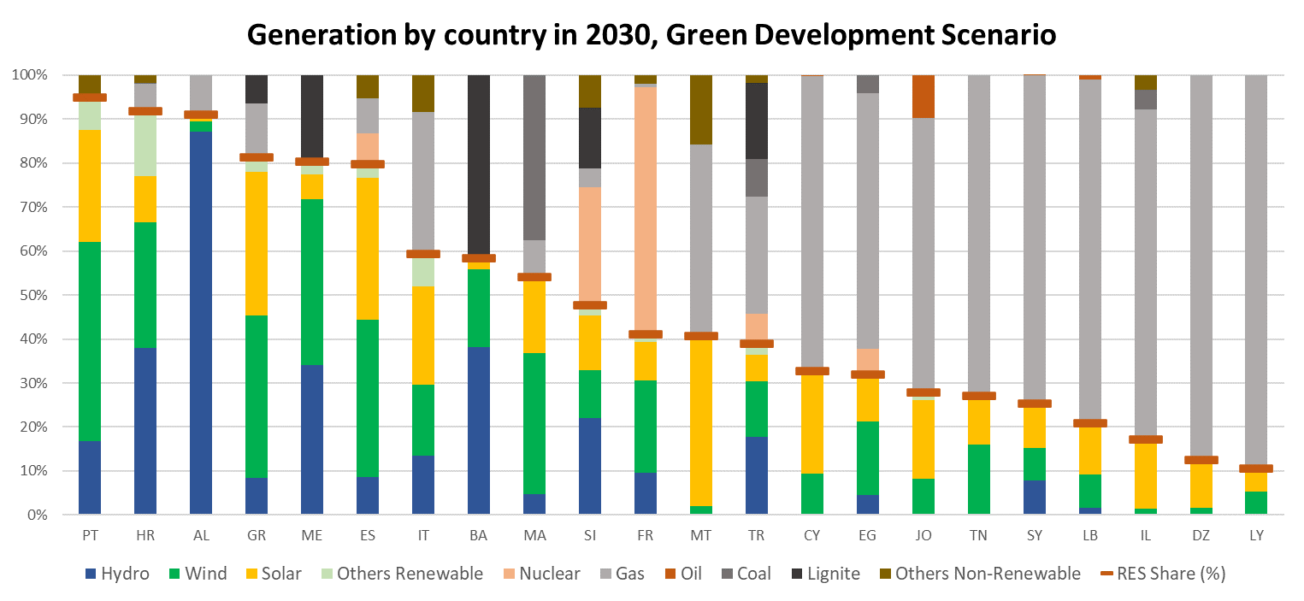
RES increase by country at 2030

Slide 12
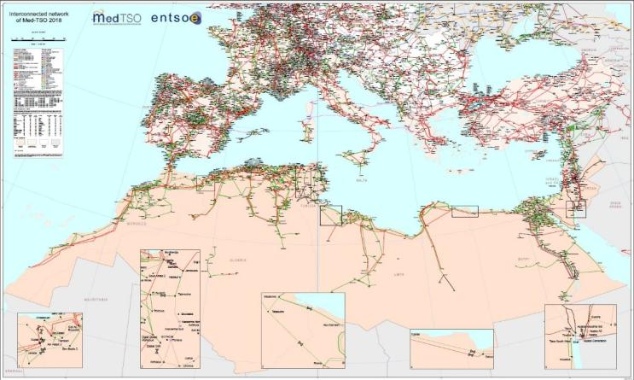
The Mediterranean electricity grid

Slide 13



Main streams of Med-TSO’s action plan
a
b
c
d
Coordinated planning
Common rules
Capacity building
Interconnected Electricity Exchange Zones
  Coordinated development of HV grid
  Med Masterplan
  Power System interoperability
  Mediterranean Grid Code
  Training
  Knowledge Sharing programs
  Coordinated Adequacy assessments
  Enhance coordination in operations
2020
2022
2015
2018

Slide 14
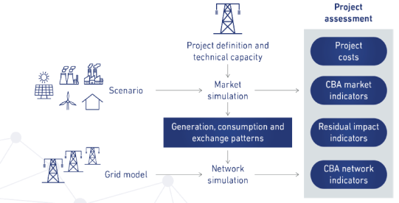
2020 MMP assessment framework
The 2020 Mediterranean Masterplan is a set of coherent activities:
definition of consistent energy scenarios
selection of the future interconnection projects
set up of a reference model of the regional power system to perform market and network studies
Analysis of the network behavior (load flow calculations) and of the investments needed to fulfil the security requirements
Perform a Cost-Benefit Analysis (CBA) for the new investments agreed by the Members and in line with the EU methodology

Slide 15
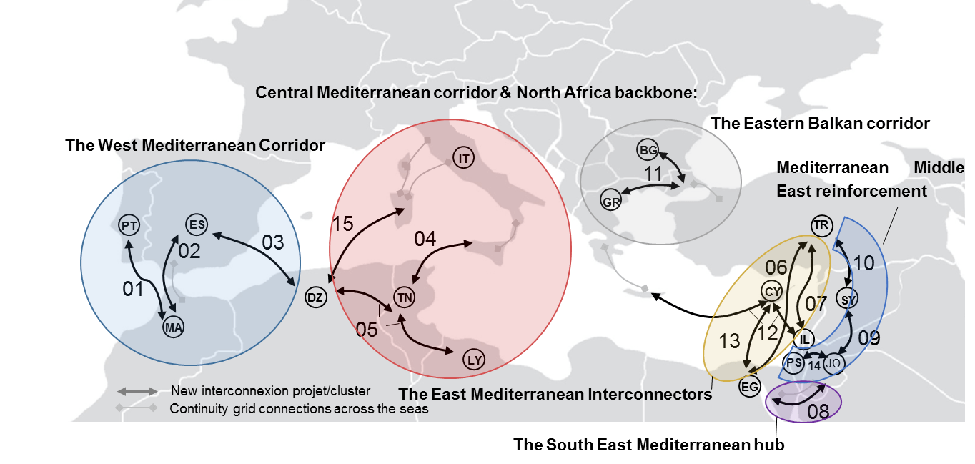
2020 Master Plan outcomes
15 projects for 5800 km of additional lines
+18 GW capacity
+12 BEUR aggregated investment costs
+4100km HVDC
€
AC
DC
Selection of projects
Market and network studies
Cost-Benefit Analysis
https://masterplan.med-tso.com
https://data.med-tso.com
A new 2022 MMP in progress

Slide 16
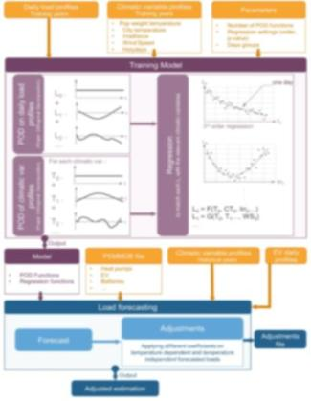
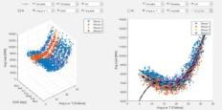
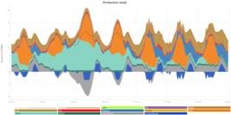
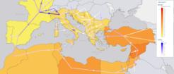
TEASIMED – Evolution of Scenarios & Market Models
MP2 - Three scenarios at year Horizon 2030
  National Development
  Green Development
  Mediterranean Evolution
  TEASIMED - Long-term planning & decarbonisation strategy for 2050
  Extending the EU Green Deal concepts to the Med Region: Med-TSO e-highway 2040-50
  Sector Coupling perspectives and possible implementation of Power2Gas
HERE PICTURE
HERE PICTURE

Slide 17
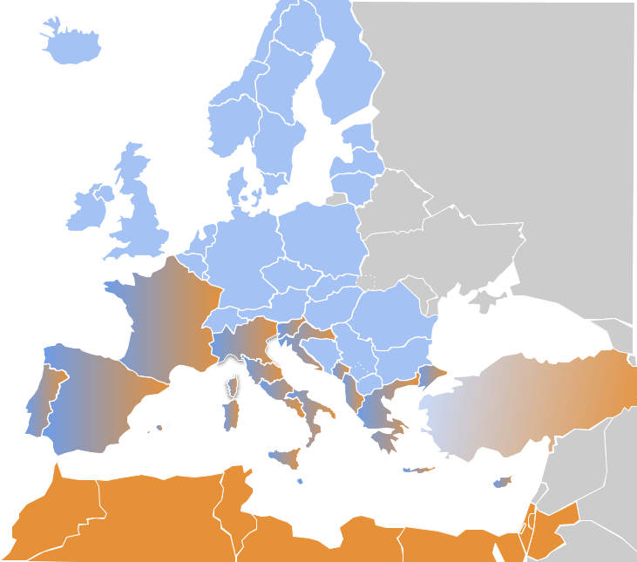
TEASIMED – Towards a Mediterranean Grid Code
From a Common Technical Regulatory Framework (CTRF) to a Mediterranean Network Code
Institutional Support
Operation
Emergency & Restoration
Operations
Cybersecurity
Role of TSOs
NRAs
Regional Organizations
Grid Codes
National Institutions
Connection
Demand Connection Code
Requirements for Generators
HVDC Connections
Market
Forward Capacity Allocation
CACM
Electricity Balancing
Public Acceptance

Slide 18

TEASIMED – Launching pilot projects
TWO PILOT PROJECTS: WESTERN & EASTERN ZONES
Start the preparation of coordinated national Network Development Plans
Start implementing a coherent and harmonized set of Technical Rules for managing the existing interconnections
Promote the effective Operation of the interconnected power systems, also through the use of a Web based platform
FR
SL
HR
IT
ME
ES
AL
PT
GR
TR
TN
CY
MA
ZONE 1
PS
DZ
IL
JO
LY
ZONE 2
EG
Mediterranean countries not MedTSO members

Slide 19
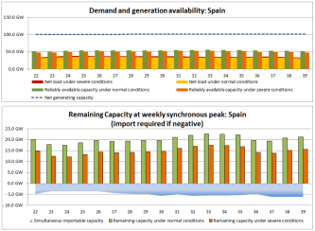
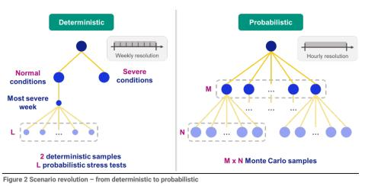
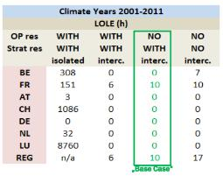
TEASIMED – Coordinated adequacy assessment
  Does the country ‘A’ have enough capacity to cover power demand even under severe/extreme conditions?
  How could the interconnection reduce shortage situations?
from deterministic to probabilistic

Slide 20






TEASIMED – Knowledge Sharing programme
Knowledge Sharing → workshops with the key stakeholders
Launch of common trainings → dedicated comprehensive training courses for Med-TSO members on relevant topics

Slide 21
Conclusions
Energy transition is a sine qua non to achieve sustainable growth all over the world and tackle climate changes, requiring substantial increase of investments in renewable electricity generation and grids
The electricity infrastructure is one of the main enablers to achieve the transition and TSOs are the driving force
Innovation and new technologies are key
Focus on the Mediterranean region: need to develop the electricity infrastructure
Need to promote both the HW (development of the grid) and the SW (common ground rules) for achieving system interoperability (role of Med-TSO)
Need to overcome the existing “non-technical barriers”, institutional and financial in primis (role of regional institutions and stakeholders)

Slide 22

thank you!
Co-funded by
the European Union

